Slide 1
Welcome to you all! We are the team that have been chosen to keep you updated about our amazing sponsored puppy, Moose.
This is Pupdate Number 1; Moose’s journey has begun…

Slide 2
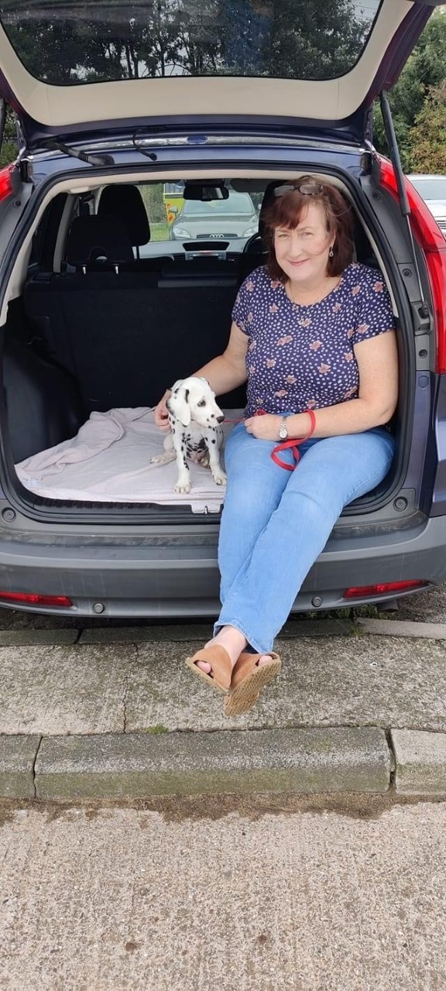
We would like to thank our previous School Business Manager, Mrs Summerson, who has sponsored a puppy from Guide Dogs on behalf of St Cuthbert’s Primary School.

Slide 3
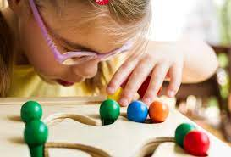
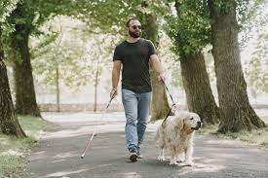
Did you know that one in five people will live with significant sight loss in their lifetime? By sponsoring a puppy, we are helping to transform the lives of both adults and children with visual impairments.

Slide 4
Moose lives with his Puppy Raiser Sandra, who will train him to the best of her ability and give him the best possible preparation for his future as a life-changer.

Slide 5
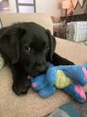
Moose is a very confident pup - he’s really outgoing and not afraid of anything, he loves to play and his favourite thing to do is nibble on his friends’ ears!

Slide 6
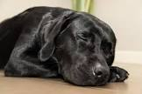
Z
Z
Z
Z
Z
Z
Z
One funny fact about Moose is that he’s a real snorer - his family can’t believe such a loud sound could come from such a tiny pup!

Slide 7
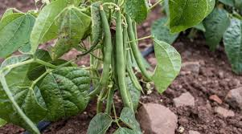
Moose has now had all of his vaccinations, and has been training on his walks. He recently attended a puppy class and won first prize on the assault course.
Moose is really quick to learn but he can be mischievous, as the green beans in Sandra’s garden discovered!

Slide 8
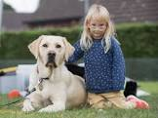
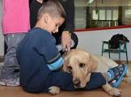


The Guide Dogs bring a new friend into the lives of children with sight loss. By helping them to develop their self-confidence, improve relationships and build a greater sense of trust, these dogs can have a hugely positive effect on a child’s wellbeing – and their family, too.

Slide 9
Thank you so much to St Cuthbert’s Primary School for supporting Guide Dogs by sponsoring a puppy.
You have helped to change someone’s life forever!

