Slide 1
Online Safety

Slide 2
AGENDA
>Importance of online safety
>What we teach about online safety
>Strategies to support families
>Advice

Slide 3
Safer Internet Day 2023

Slide 4
The importance of online safety
❖Children need to be aware of the impact that their online activity can have on both themselves and other people, and the digital footprint that they create ion the internet
❖It’s easy to feel anonymous online and it’s important that children are aware of who is able to view, and potentially share, the information that they may have posted
❖When using the internet, it’s important to keep personal information safe and not share it with strangers.

Slide 5
The importance of online safety
❖Some online content is not suitable for children and may be hurtful or harmful: social networks, online games, blogs and websites;
❖Fake news: it is important for children to consider the reliability of online material and be aware that it might not be true or written with a bias
❖There can be legal consequences for using or downloading copyrighted content, without seeking the author’s permission

Slide 6
The importance of online safety
❖Some online content is not suitable for children and may be hurtful or harmful: social networks, online games, blogs and websites; ALWAYS check age and content https://www.commonsensemedia.org/ provides up to date reviews and helpful guides for parents.
❖Fake news: it is important for children to consider the reliability of online material and be aware that it might not be true or written with a bias
❖There can be legal consequences for using or downloading copyrighted content, without seeking the author’s permission

Slide 7
Importance of Online Safety
❖Children need to understand their actions online can be just as hurtful as offline actions and that deliberately seeking to hurt or upset someone is always unacceptable.
Talk to your child about sharing things on the internet, this may be sharing information or chatting to others but could also reach to sharing images or videos without permission or of a sexual nature. Younger children often find this ‘funny’ and don’t recognise this as a serious matter until things are taken too far.

Slide 8
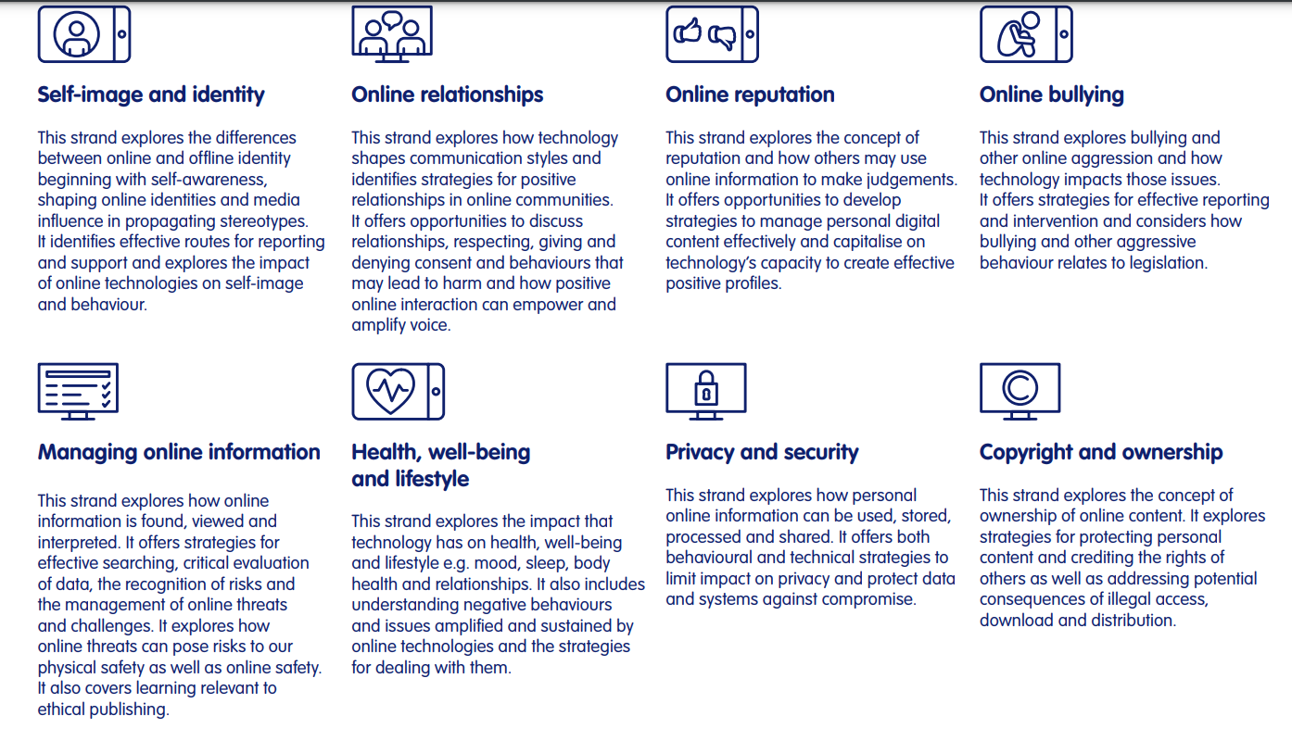
What we teach
Our online safety curriculum, from EYFS to KS2, is based around ‘Education for a connected world’- a government framework to support all aspects of online life.

Slide 9
Supportive Strategies
Set out ground rules and expectations for the family – when do adults and children use their devices,
• when are devices put away,
• where are devices kept during the night,
• what apps/websites are the children using,
• what should happen if something pops up unexpectedly on the screen,
• what should happen if someone unknown gets in contact, asks to be a friend, asks for personal information, images or even to meet up,
• how people should communicate with each other online and what should you do if someone does communicate in a hurtful way

Slide 10
Advice and Support
Our School Website offers Monthly online news lead by the children and termly newsletter
Other Useful Websites
For further information please use the listed websites below which contain a wealth of knowledge and expertise about internet safety.
https://www.nspcc.org.uk/keeping-children-safe/online-safety/
https://www.childnet.com/parents-and-carers/
https://saferinternet.org.uk/
https://www.thinkuknow.co.uk/
https://parentzone.org.uk/
https://www.youtube.com/myfamily/?gclid=Cj0KCQiA2sqOBhCGARIsAPuPK0h3gNmafc9FS-QlSOyubQdAUQuJ-HDXB77k10P3ItgRuuWB3bEBuRAaAvycEALw_wcB&gclsrc=aw.ds
https://www.stcuthbertsk.org/web/e-safety/174234

