Slide 1
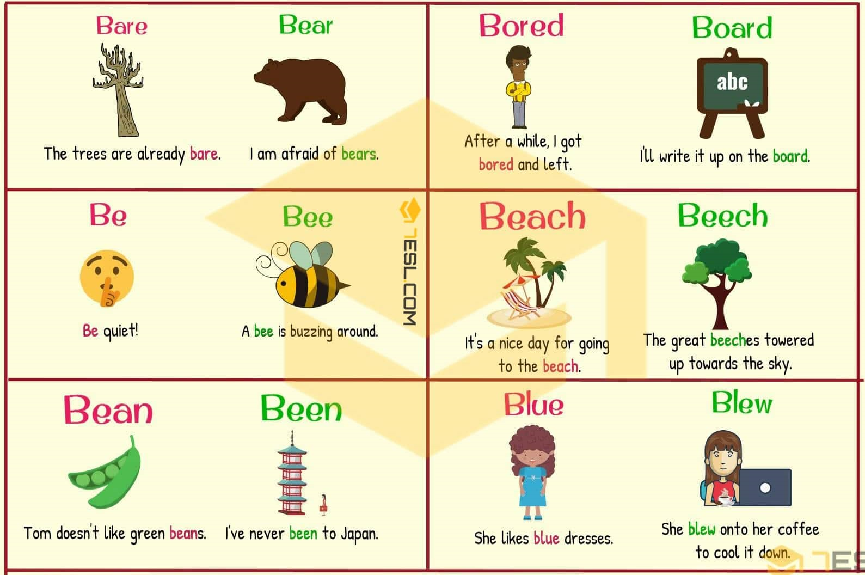
LO: to revise homophones
Homophones – different spelling of words with different meanings, used in different contexts, same sound
their – possession – TIP: ‘i’ own something, this word contains an ‘i’
there – position – TIP: it contains the word ‘here’
they’re (contraction of ‘they + are’) – TIP: think about the sentence you are writing, does ‘they are’ fit with what you want to say?
Task: Write an example for each in a sentence

Slide 2
LO: to revise homophones
to – indicates movement, used to make indirect objects or infinitive of a verb
too – many, overly more TIP: it contains two ‘o’ (oo), one too many!
two – number
Task: Write an example for each in a sentence
where - position – TIP: it contains the word ‘here’
wear – clothes
we’re (contraction we + are) - TIP: think about the sentence you are writing, does ‘we are’ fit with what you want to say?
Task: Write an example for each in a sentence
** were is a commonly mistaken word which sounds differently to where.

Slide 3
LO: to revise homophones
for – person benefitting from, receiving something
four - number
fore – to the front
Task: Write an example for each in a sentence
of – belonging, connected with
off – away from, cancelled
Task: Write an example for each in a sentence
‘of’ and ‘off’ are included in this exercise. They’re not homophones but they’re often mistaken in writing

Slide 4
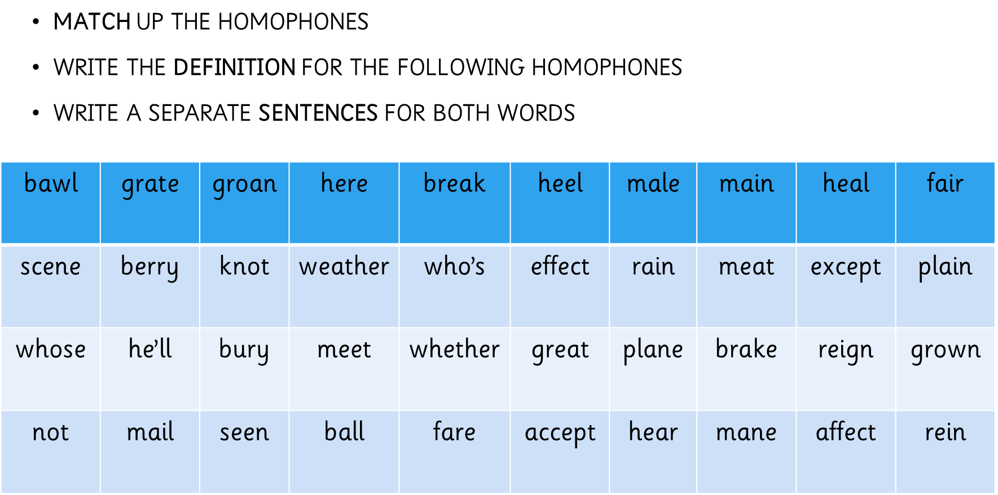
LO: to revise homophones

