Slide 2
Diving into Mastery Guidance for Educators
Each activity sheet is split into three sections, diving, deeper and deepest, which are represented by the following icons:
These carefully designed activities take your children through a learning journey, initially ensuring they are fluent with the key concept being taught; then applying this to a range of reasoning and problem-solving activities.
These sheets might not necessarily be used in a linear way. Some children might begin at the ‘Deeper’ section and in fact, others may ‘dive straight in’ to the ‘Deepest’ section if they have already mastered the skill and are applying this to show their depth of understanding.
Diving
Deeper
Deepest

Slide 3
Aim
Identify common factors, common multiples and prime numbers.

Slide 4
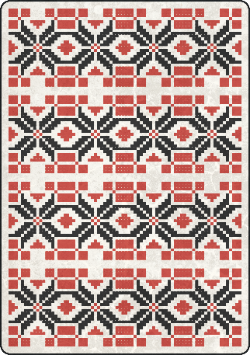
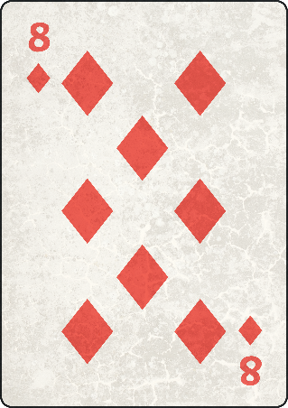
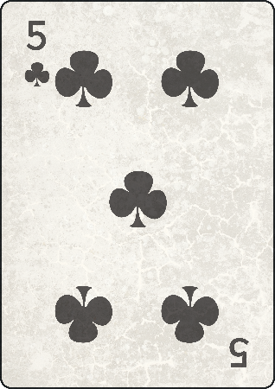
Primes to 100
Diving
13
17
19
23
11
These cards show prime numbers and are arranged in ascending order.
Which prime numbers are on the mystery cards?

Slide 5
Primes to 100
Diving
Use your multiplication and division facts to break this number down into its prime factors.
48
92
6
2
46
8
2
3
4
2
23
2
2
2

Slide 6
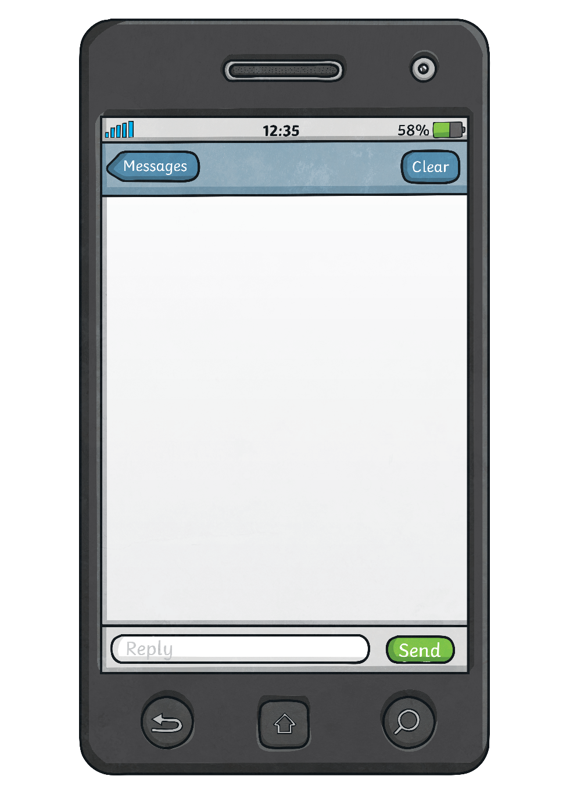
Primes to 100
Deeper
Do you agree? Explain your reasons.
“I have shaded all the prime numbers between 40 and 50.”
41 | 42 | 43 | 44 | 45 | 46 | 47 | 48 | 49 | 50
The answer is incorrect. 49 is not a prime number, as 7 × 7 = 49.

Slide 7
Jen
Dan
40
40
2
20
10
4
4
5
5
2
2
2
Primes to 100
Deeper
Jen and Dan have used factor trees to break down 40 into its prime factors. Whose answer is correct? Explain any errors.
Dan is correct. Jen has not broken 4 into its prime factors (2 and 2).

Slide 8
Primes to 100
Deepest
7 | 14 | 18 | 43 | 77
There are four possible statements:
14 – 7 = 7
18 – 7 = 11
Use these numbers to make subtraction statements with answers that are prime numbers.
How many statements can you make?
43 – 14 = 29
77 – 18 = 59

Slide 9
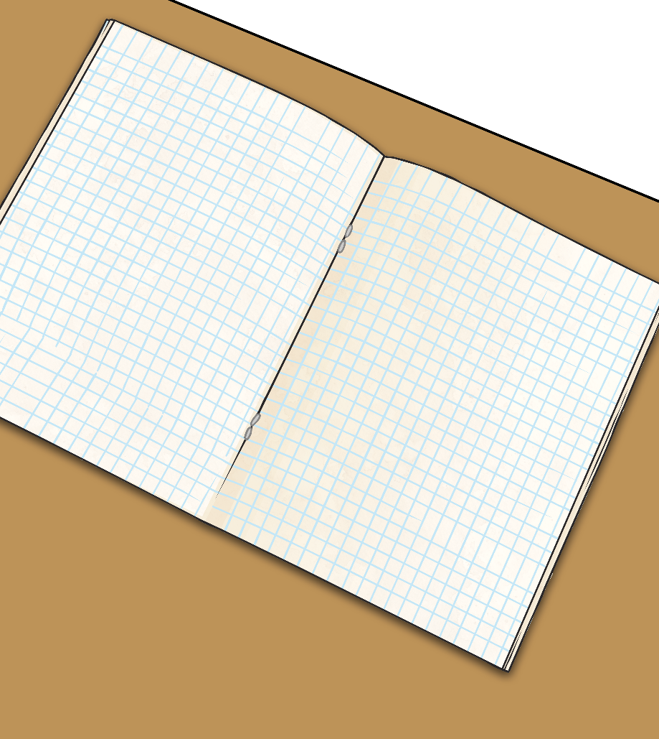
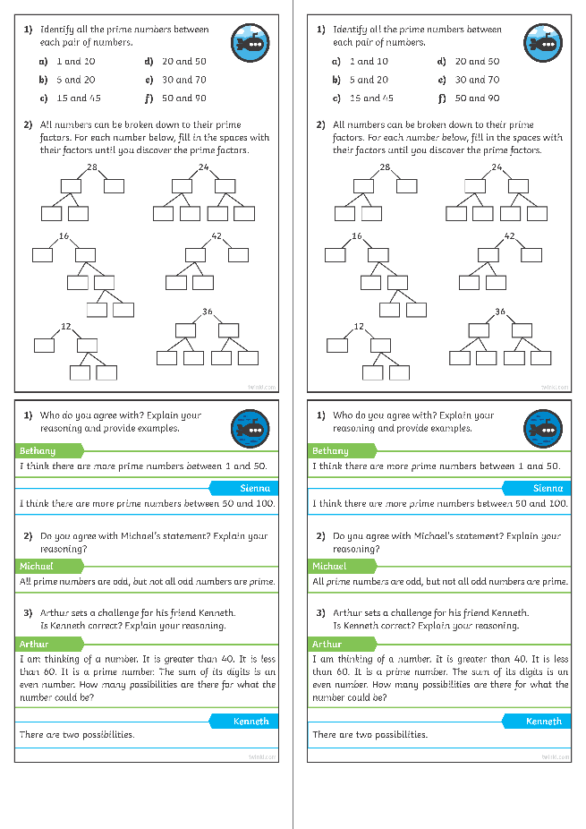
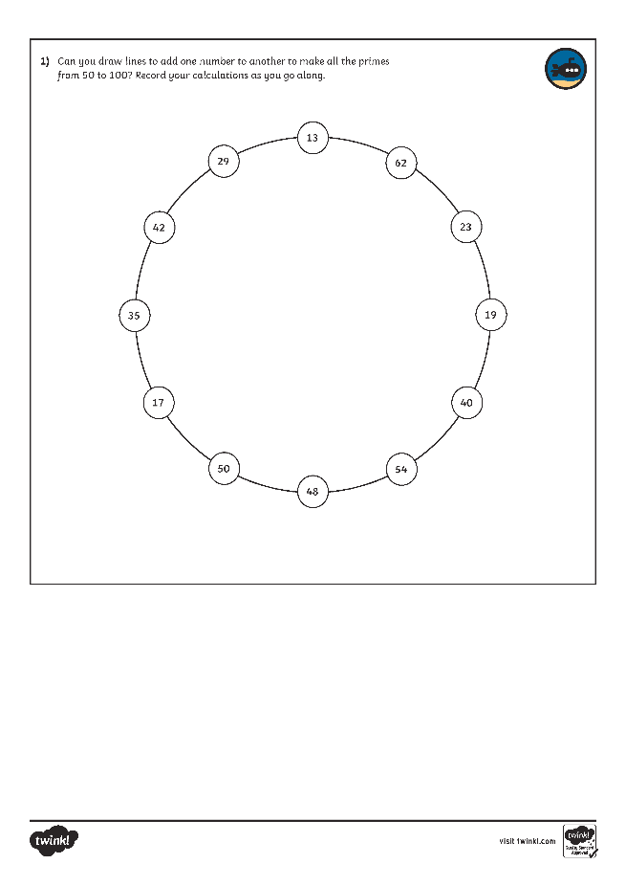
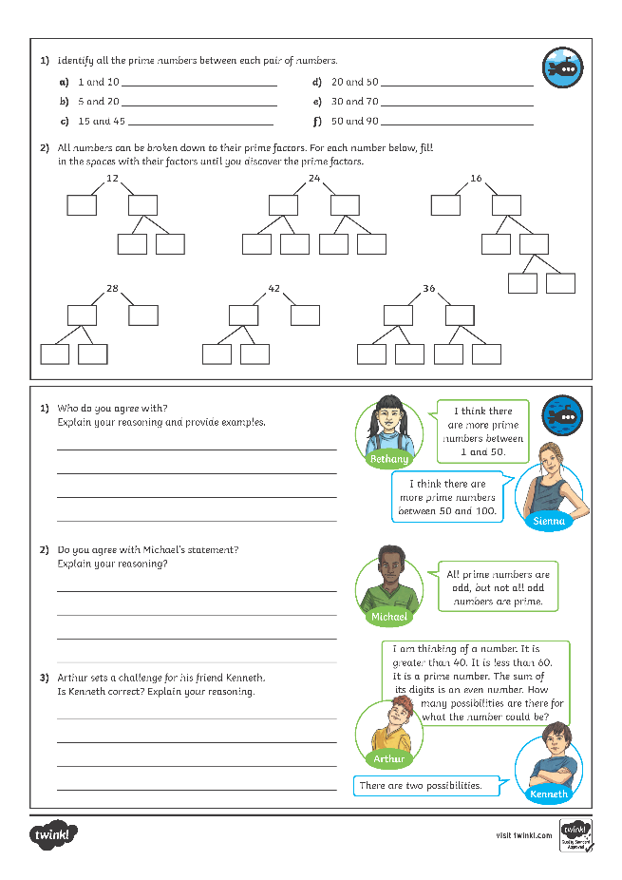
Primes to 100
Dive in by completing your own activity!

Slide 10
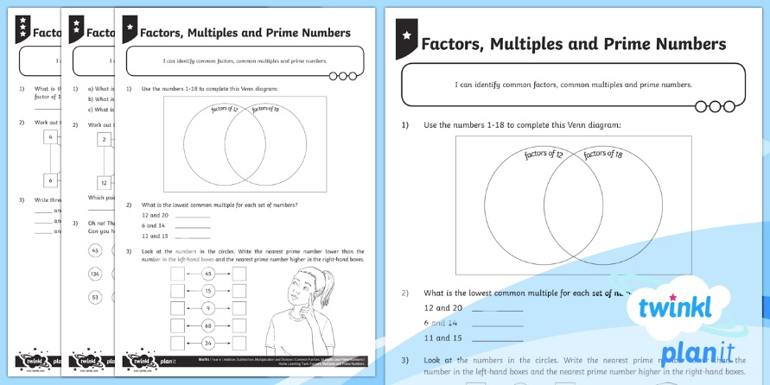
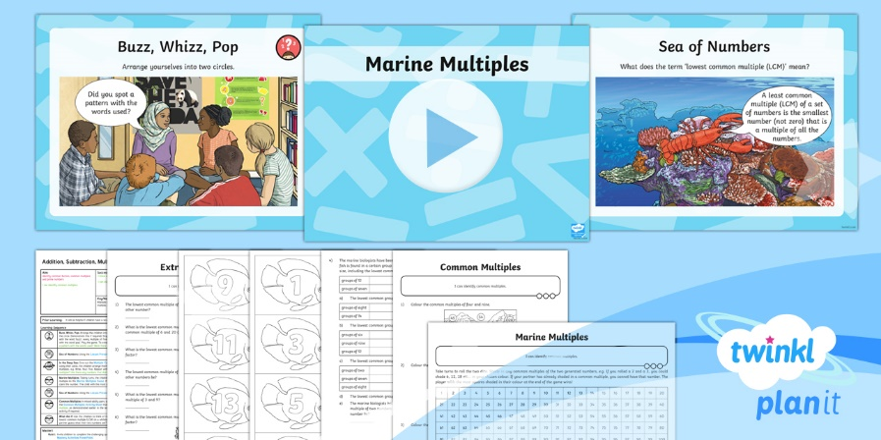
Need Planning to Complement this Resource?
National Curriculum Aim
Insert National Curriculum Aim here.
For more planning resources to support this aim, click here.
Twinkl PlanIt is our award-winning scheme of work with over 4000 resources.

