Slide 1
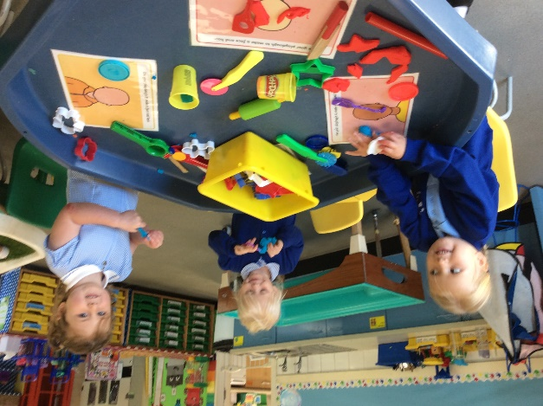
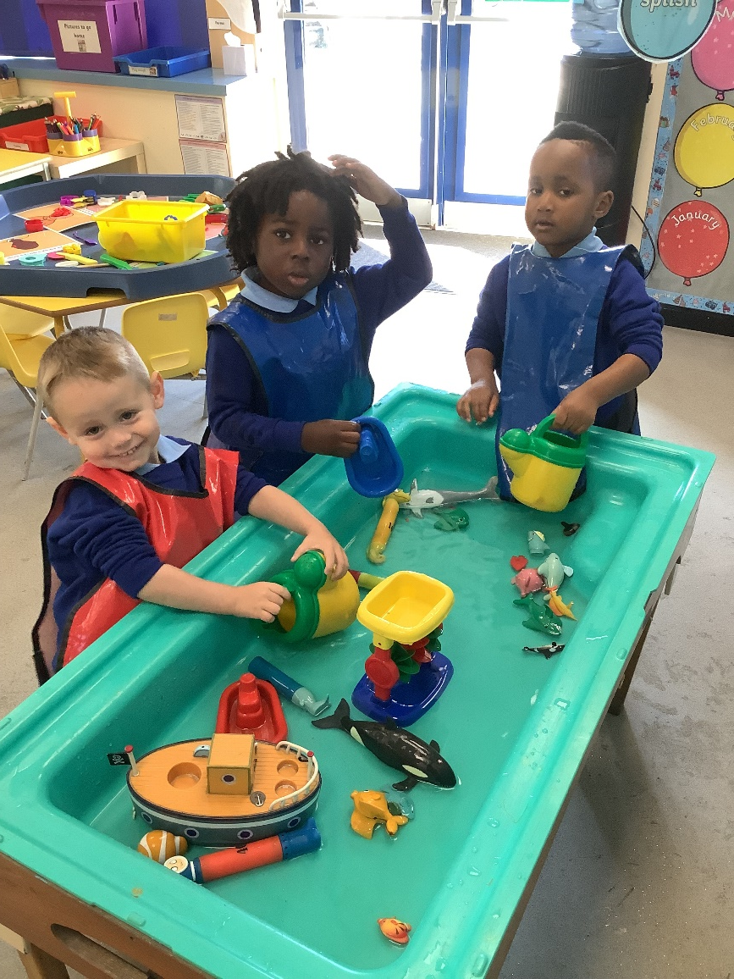
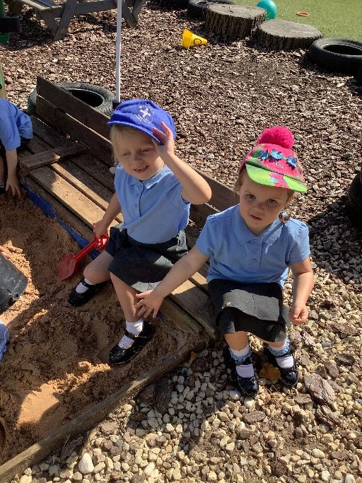
Nursery Curriculum
November 2023

Slide 2
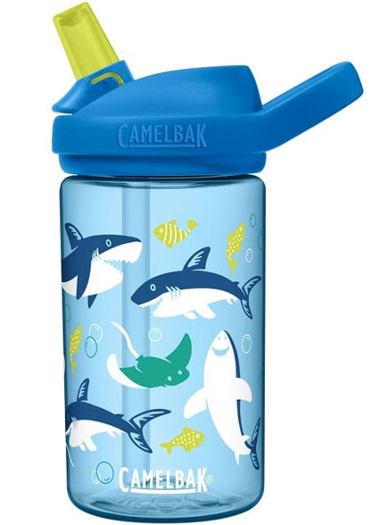
What your child needs to bring to school:
A water bottle with water only inside –No Juice (labelled with their name)
A packed lunch unless they are having a school lunch
Please ensure they have appropriate clothing to wear outside as a lot of the Early Years Curriculum involves playing outdoors. In the colder weather, they will need their coat, hats and mittens or gloves.
Please ensure all of their clothing, water bottles, packed lunches and bags are labelled.

Slide 3

Days and Times
Gate Opening Times;
Monday- Friday - 8:30- 8:45 - 3:-3:15
We have some sessions available for £15.00 per session (sessions-am /pm – so for a full day would be £30 (please contact the office or Miss Graham)

Slide 4

What happens during the day ?
Timetable from November 2023
8:30-8:45 –doors open
8:45-9:10-Play in the classroom, do register
9:10-9:25 – Gather round to look at visual timetable. Sit in circle for: Prayer, wake up shake up and whole class CAL/topic work
9:25-10:00-Independent play and Teacher Directed
10:00- 10:20- Toileting, Snack and story
10:20- 11:00- Teacher Directed and child initiated outside.
11:00- 11:30-Whole class Phonics, Toileting and song time
11:30-12:30- Lunchtime
12:30-12:35 Daily Jog
12:35-12:50-Maths Whole Class
12:50-1:50-Indoor Play-free choice and interventions.
1:50-2:00-Tidy up
2:00-2:05-Dough Disco
2:05-2:45-outside independent play and teacher directed activities
2:45-2:55- RE
2:55-3:05-Story and end of day Prayer
3:05-3:15- Story/songs and get ready for home - Home Time

Slide 5
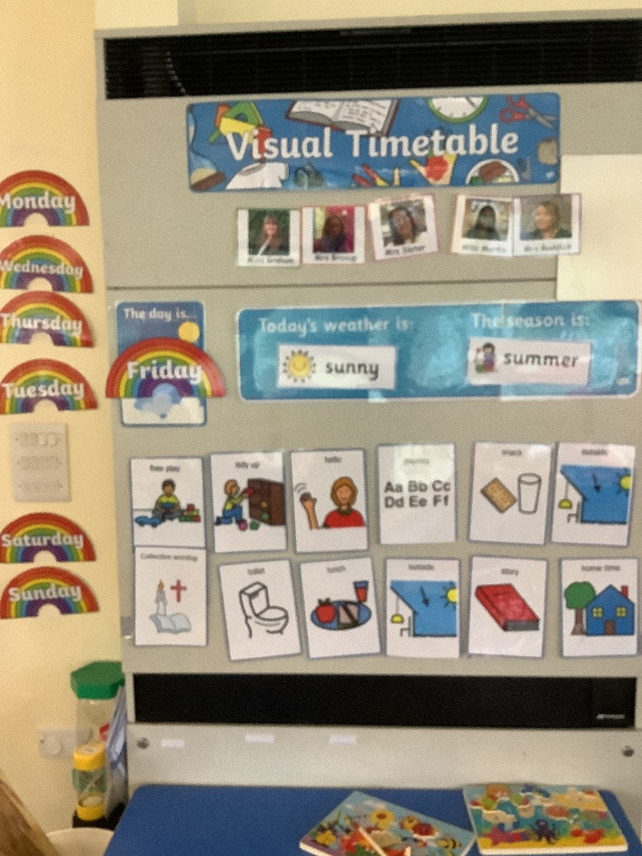
Visual Timetable
We use a Visual Timetable to show the children what is happening every day.
This is really useful and helps the children with routines.

Slide 6

The Nursery Curriculum
The Development Matters statements from birth –three and three - four are used in Nursery.
These statements are used for learning, development and care of the children.
The areas of learning are divided into prime and specific areas of learning.

Slide 7
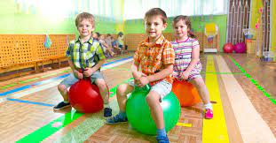
Prime Areas of Learning
Personal, Social and Emotional Development- PSED (Self-Regulation, Managing self, Building Relationships)
Physical Development-PD (Gross Motor Skills, Fine Motor Skills)
Communication and Language-CAL (Listening and Attention and Understanding, Speaking)
These are the main focus for the first term of Nursery.

Slide 8
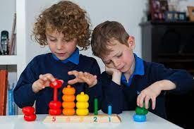
Specific Areas of Learning
Literacy (Word Reading, Writing, Comprehension)
Mathematics (Numbers, Numerical patterns)
Understanding the World (People, Culture and Communities, The Natural World, Past and Present)
Expressive Art and Design (Creating with Materials, Being Imaginative and Expressive)

Slide 9
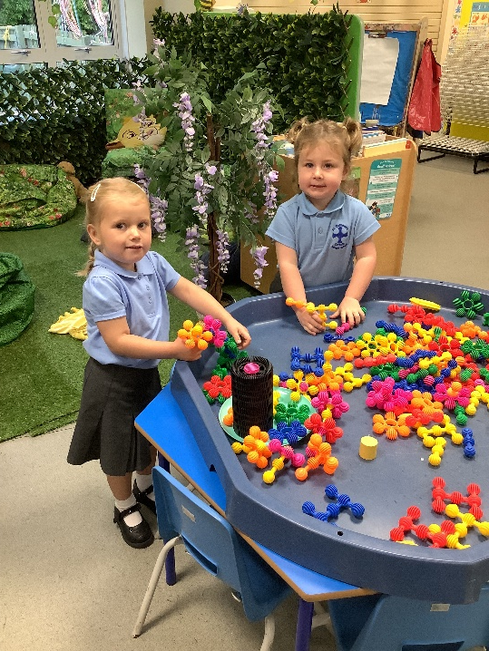
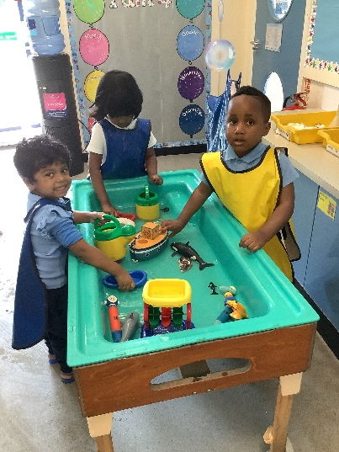
We plan topics that we think will engage and interest the children. Some of the activities the children participate in will be adult led while others may be initiated by the child. The Topic overview can be seen in the EYFS, Nursery September 2023 section of the website.
The topic overview shows you the Development Matters we are hoping the children will achieve and the activities they might participate in to develop these outcomes.

Slide 10

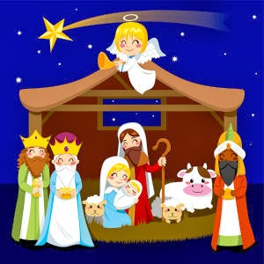
The topics we focused on to start our Nursery Journey were ‘Myself’, Autumn, Halloween.
The topics we will be looking at this term are: Bonfire Night, Pirates, Birthdays, Christmas and The Christmas Story.

Slide 11

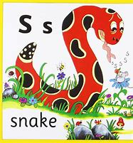

Phonics, Maths and Literacy Sessions
The children have a daily Phonics, Maths and Literacy session.
The sessions are very short and interactive.
We differentiate the teaching so that all of the children can access the teaching and everyone can make progress.

Slide 12
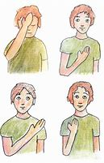
Religious Education.
Religious Education and Collective Worship are very important parts of our curriculum, as well as being integral to our spiritual life in school. We’d like to outline the things which happen in our EYFS so that you can support your child on their spiritual journey through school.
Nursery cover some of the topics in the “Come and See” RE Curriculum: “Myself”, “Birthday”, “Celebrating”, “Growing” and “Our World”. We also learn about Islam and Judaism
We make the Sign of the Cross before every prayer. We use the words “From my head to my heart, from my shoulder to my shoulder, I love you Lord Jesus”.
In the Summer term we move on to using the traditional words, “In the name of the Father, and of the Son, and of the Holy Spirit.”

Slide 13

Religious Education cont...
Every morning, the children say our School Prayer.
At the end of the school day, the children join in with an Evening Prayer. This can take the form of a simple prayer suggested by a child, or after reflection on the day’s events, a simple litany, e.g. Teacher: “for our friends” Children: “Thank you God”
Before we eat, we say the Lunchtime Prayer.
At the end of each topic we participate in a class liturgy which takes place in the school chapel. This often involves prayerful reflection, music, singing, movement, retelling a Bible story and celebrating the work we have done in the classroom.

Slide 14
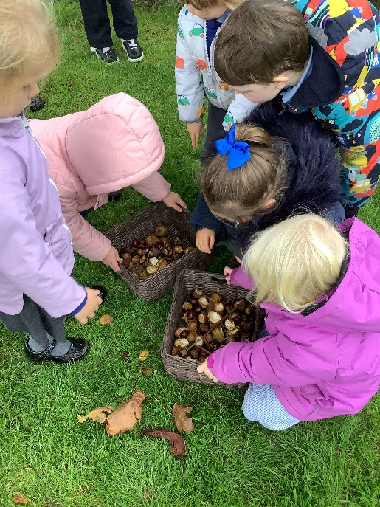
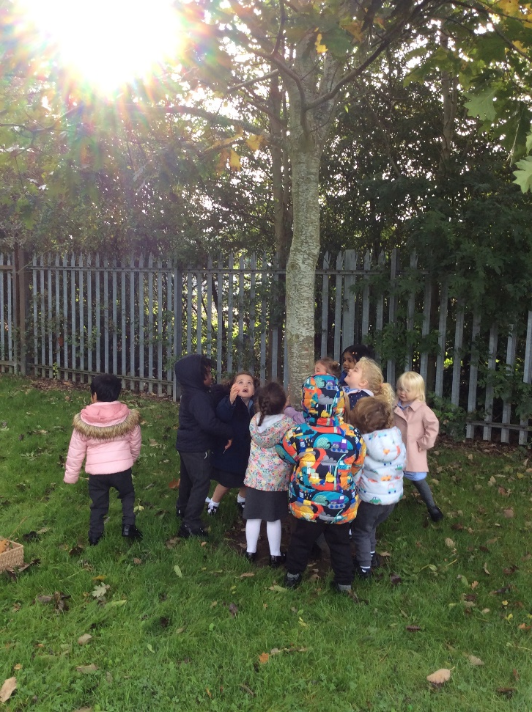
Model good language
Use new vocabulary in a way your child will understand.
Use more complex sentences when talking to your child, for example linking ideas using words like ‘because’ and ‘but’.
Model good turn taking.

Slide 15
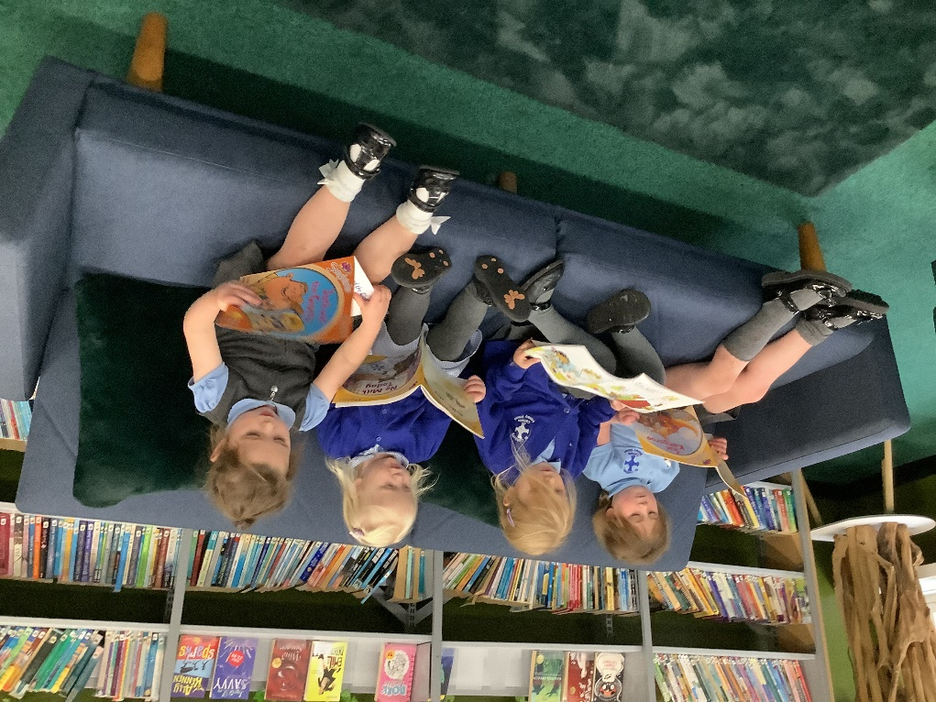
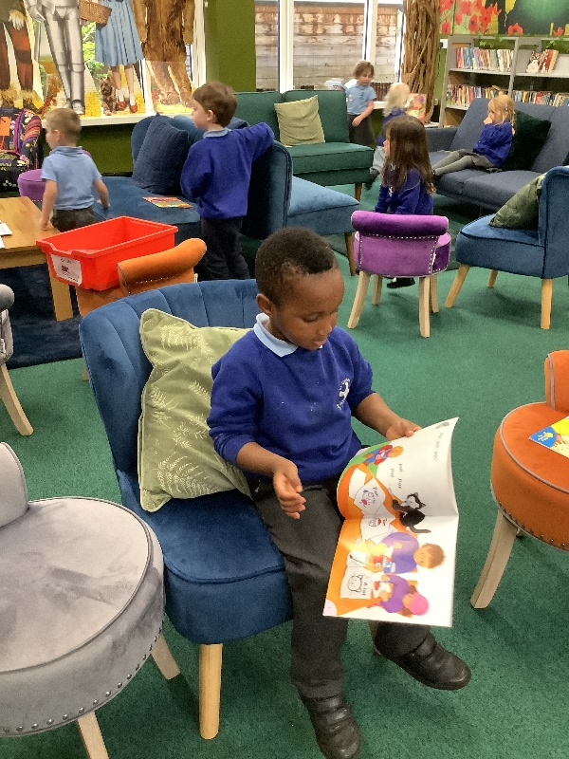
Reading
Read with your child.
Share books together.
Talk about the pictures.
Who, what and where?
Think about what might happen next.
How might the characters feel?

Slide 16
Look at numerals in the environment and count groups of objects
Numbers are everywhere! If you see a number which means something to your child, point it out and explain why it’s special, e.g. number 3 because they are 3!
Help your child to point to each object as they are saying the number name.
Encourage children to state how many is in the set altogether.

Slide 17
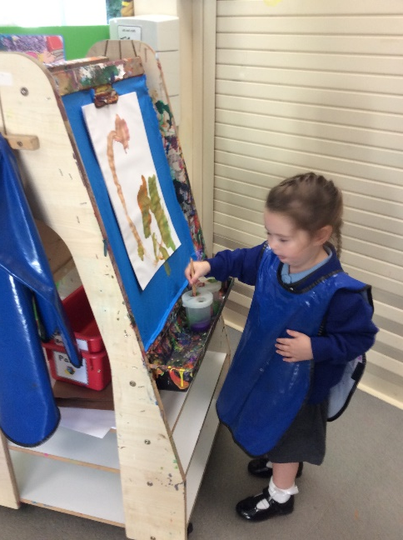
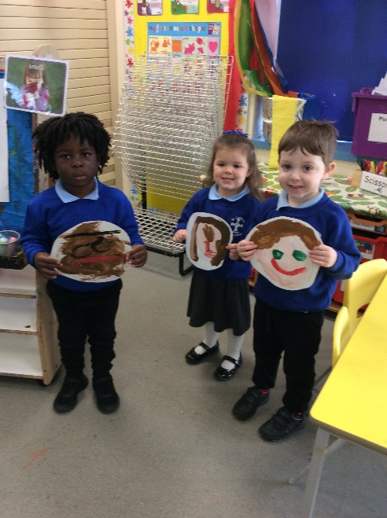
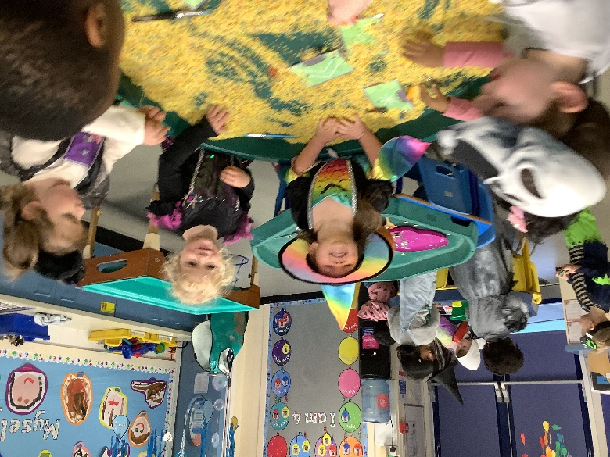
Encourage your child to mark make
Children love to make marks with all sorts of things – pens, pencils, chalk, shaving foam, flour…the list is endless!
Mark-making is the first step toward writing.
When using pens and pencils, encourage your child to use the three-fingered tripod grip.

Slide 18

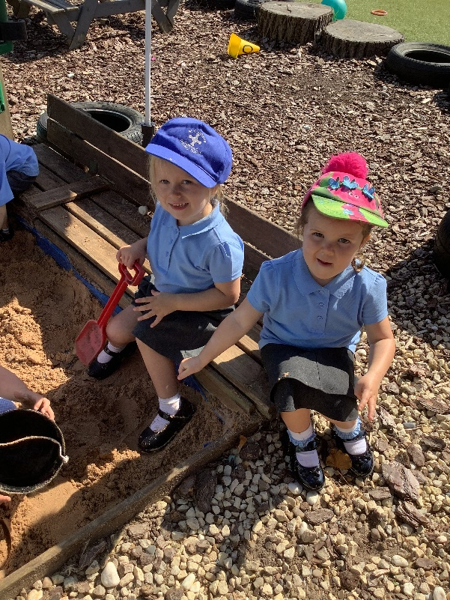
Clear expectations of behaviour
Positive praise
Stickers
Cubes in the jar (sometimes take cube out of jar)
Time out when necessary

Slide 19
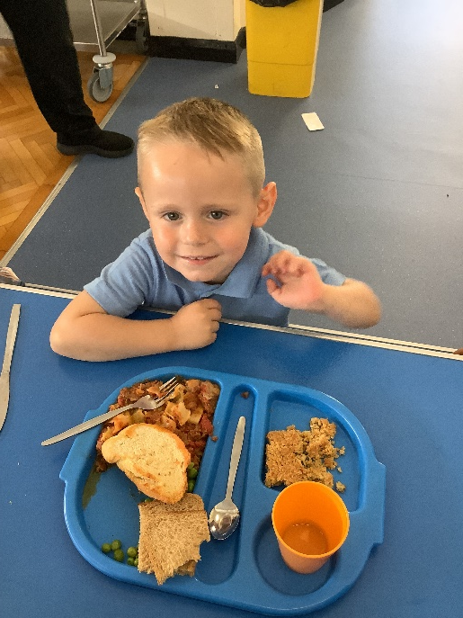
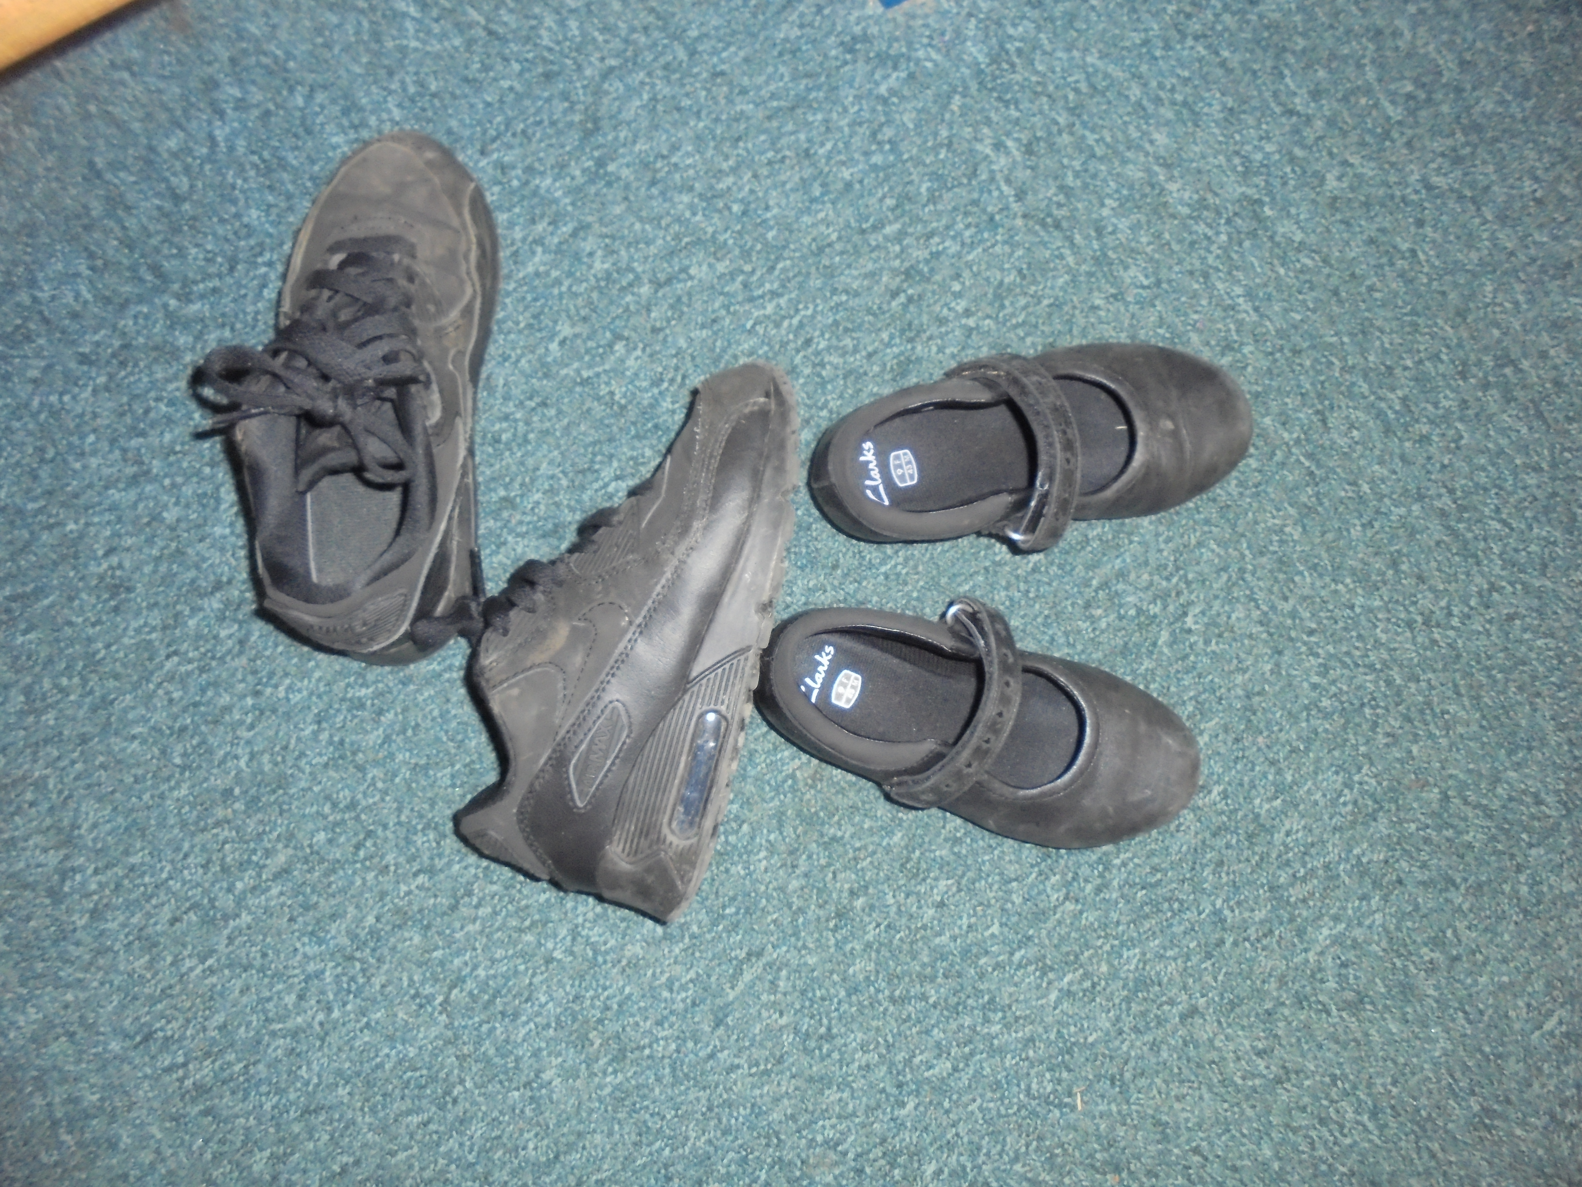
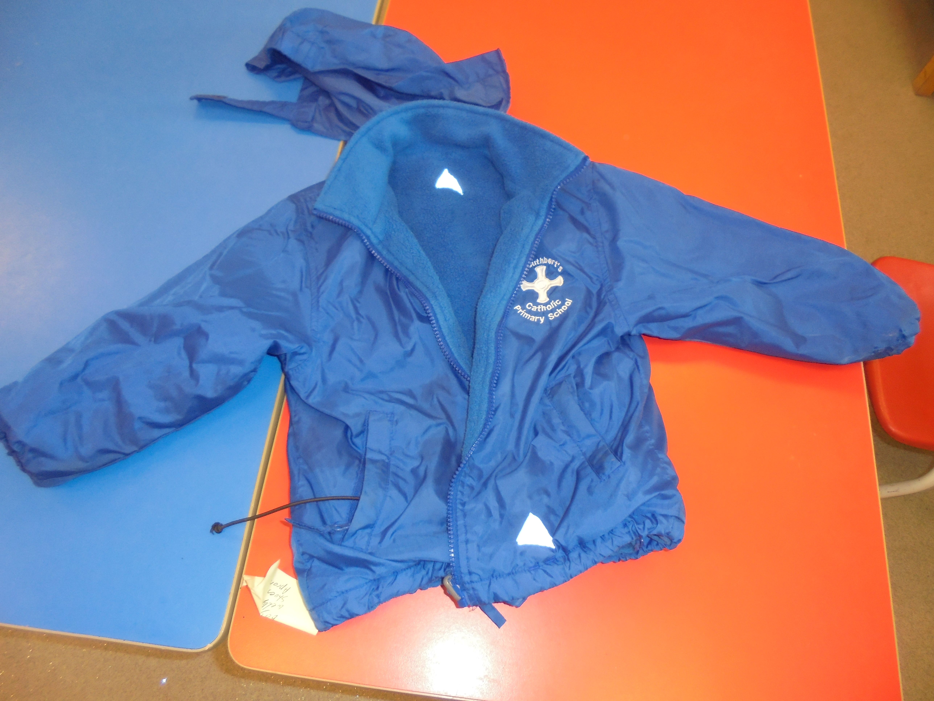
Help them to become independent
Spend some time teaching them to put their coat on.
Can they show you how they can put their own shoes on?
Encourage them to ask if they want help with something.
Continue to encourage them to use the toilet independently.
Please make sure all clothing is clearly named.

Slide 20
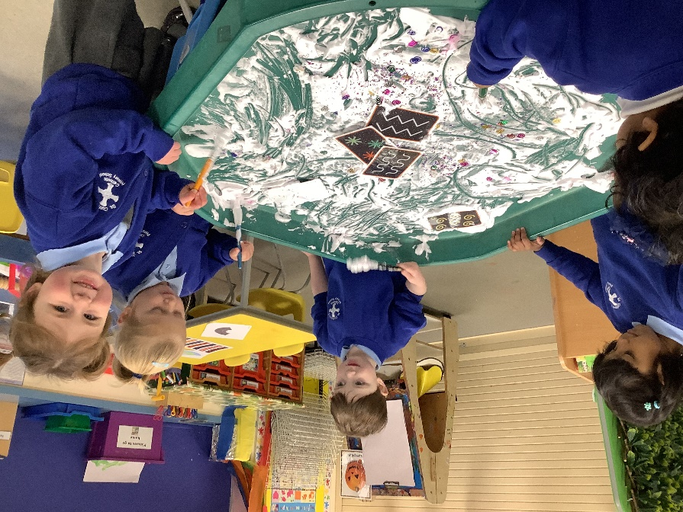
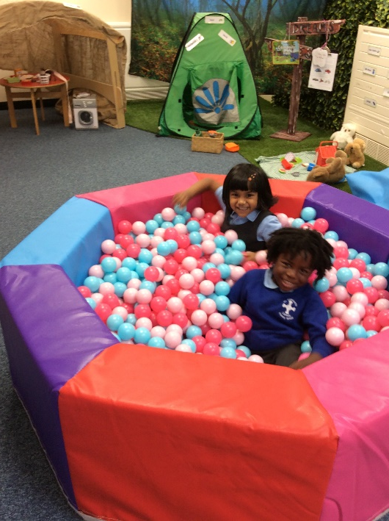
PLAY
Let your child lead the game and respond to their interests.
There are photos on the school website & Facebook that show a variety of activities that the children are participating in.

Slide 21
Safeguarding
Medicines to be administered must be prescribed to your child & forms signed.
Attendance-If your child can’t attend school parents must inform the school office.
Collecting – if changes are made, you must contact the school and let us know who is collecting your child. Passwords have been provided.
No jewellery.
No Mobile phones to be used in school.
We follow the signed photo consent agreement for Learning Journeys.

Slide 22

School Website www.stcuthbertsk.org
EYFS Section
Find photographs of activities the children have been doing in ‘Nursery Class September 2023’,
Phonic Guidance
Topic overviews showing the Development Matters the children are learning.
Newsletters
EYFS Curriculum
Policies
RE PowerPoints with photographs & text showing the activities the children have participated in for each topic.

Slide 23
School Facebook & Twitter
If you would like to be view the posts on Facebook then search for St Cuthbert’s Catholic Primary School and ask to join the group. This is a closed group that only allows the families of St Cuthbert’s pupils to view any posts.
Facebook and photographs posted in the EYFS section of the website are a good way of seeing what activities the children have been doing at school.
We also have a school Twitter account for parents to follow.

